Slide 1

Power BI Sales Analytics with AI Capabilities
Internship Project
Duration = 14th July to 29th Aug 2025
Aditya Sharma

Slide 2
Agenda
1
2
3
4
5
6
Introduction
Executive Summary
Forecasting
AI Analysis
Learning
DEMO

Slide 3
Introduction
Power BI Sales Analytics Dashboard with AI capabilities provides comprehensive insights into sales performance across multiple dimensions(Electronics, Household , Personal Care, Beverages, Snacks) enabling data-driven decision-making for business growth.
Technology Used
Power BI
Python-3.13.5
Key Business KPI (April 2025 – Till Date)
Total Sales
Total Revenue
Forecasting
Sales Trend
Strategic Value Proposition
Real-time sales monitoring and performance tracking
Multi-dimensional analysis across products, locations, and time
Giving potential sales with respect to the product category at particular locations using AI
Anomaly detection for proactive business management using AI

Slide 4
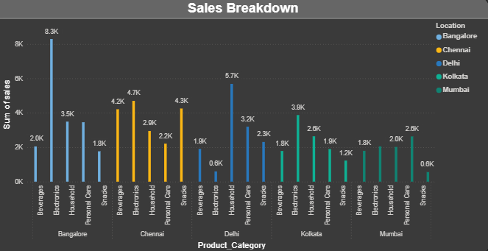
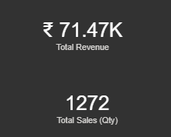
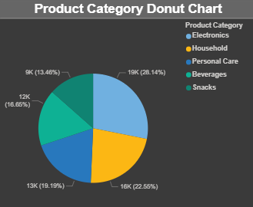
Executive Dashboard
Purpose:-
High-level KPI monitoring for leadership
Key Visualizations:-
Product Category Donut Chart (5 categories)
Location-based Sales Breakdown
Time-series Sales Trend Analysis (will show in Demo)
Interactive Geographic Mapping (will show in Demo)

Slide 5
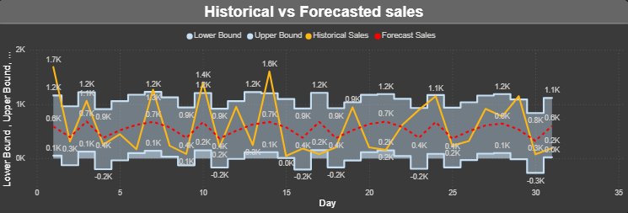
Forecasting Dashboard
Advanced Analytics Capabilities:-
‘n’-day sales forecasting with
99.72% accuracy
Historical vs. Forecast analysis
Upper and lower bound forecasting
Weekly forecast breakdowns

Slide 6
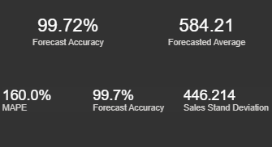
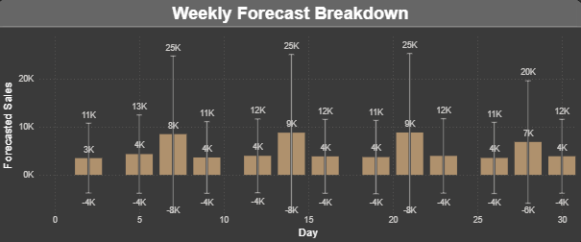
Forecasting Accuracy Metrics
Forecast Accuracy: 99.72%
Forecast Average: 584.21
Forecasting Insights
Trend Analysis: Consistent daily sales pattern around 2.0K-2.6K range
Seasonal Patterns: weekly variations identified and modeled
Strategic Value
Resource Planning: Allocate resources based on forecasted demand
Performance Monitoring: Early warning systems for deviations

Slide 7
Product Performance Analysis
Strategic Insights:-
Electronics dominates with over ¼ market share
Top 3 categories account for 69.45% of total sales
Balanced portfolio distribution reduces risk concentration
Opportunity for growth in the Beverages segment
Category | Sales Volume | Revenue Share | Performance
Electronics | 19K units | 27.28% | Leading category
Household | 17K units | 23.46% | Strong performer
Personal Care | 13K units | 18.71% | Stable growth
Snacks | 12K units | 16.41% | Consistent demand
Beverages | 10K units | 14.13% | Seasonal variations

Slide 8
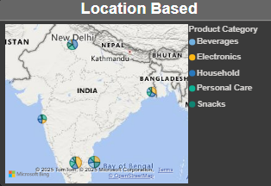
Geographic Performance & Market Penetration
Location-Based Sales Analysis (Top Performing Cities):-
Bangalore - Market Leader
Electronics: 8.3K | Household: 4.7K | Personal Care: 5.7K
Total Contribution: Highest across multiple categories
Chennai - Strong Secondary Market
Balanced performance across all product lines
Consistent Electronics demand (4.3K units)
Delhi - Growing Market
Strong in Personal Care (3.2K) and Electronics (3.9K)
Potential for expansion
Market Insights:-
Geographic Diversification: Operations across 5 major metros
Regional Preferences: Electronics perform consistently across all locations
Growth Opportunities: Kolkata and Mumbai show potential for expansion

Slide 9
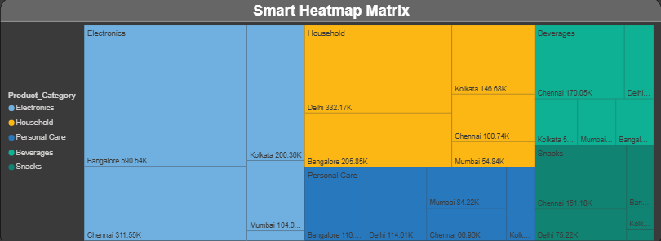
AI Analysis Dashboard
Machine Learning Integration:-
Smart Heatmap Matrix for category-location performance
Holiday impact analysis
Anomaly detection algorithms
Risk assessment

Slide 10
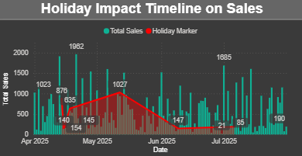
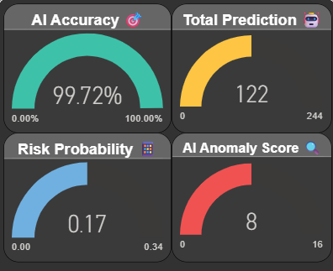
Smart Analytics Features:-
Heatmap Matrix: Visual correlation between products and locations
Holiday Impact Analysis: Seasonal trend identification
Anomaly Detection: Automated outlier identification
AI Insights Summary:-
Recommendation Engine: Focus area identification
Trend Analysis: Strong downward trend detected
Holiday Performance: Comprehensive festival impact tracking
Business Impact:-
Proactive Decision Making: AI-driven recommendations
Risk Mitigation: Early warning systems
Opportunity Identification: Market gaps and growth areas

Slide 11

Learnings
Gained hands-on experience with specific tools like Power BI, Python.
Understood the working and the work culture of an IT company .
Learned how to work with real-world datasets and apply analytics for decision-making.
Understood the importance of continuous learning in the IT field.
Developed a problem-solving mindset for technical challenge.

